Slide 1

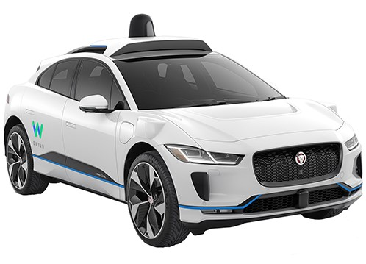
Autonomous Driving Vehicle
-Under Guidance
Prof. Donald Sofge
-By
Toyas Dhake (116507271)
Notes:
Hi, my name is Toyas Dhake and my project topic is Autonomous driving vehicle using Evolutionary Artificial Neural Networks.

Slide 2
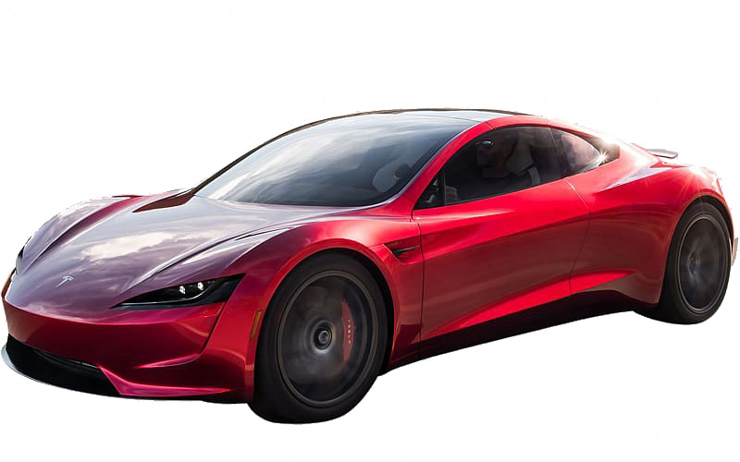
Introduction
Autonomous driving vehicle are vehicles capable of sensing their environment and safely acting upon it without or little human input.
There are 5 levels of autonomous vehicles.
Notes:
Slide
Ranging from cruse control at level 1 and fully autonomous vehicle at level 5 where even steering wheel is optional. Tesla’s autopilot is at level 2.

Slide 3
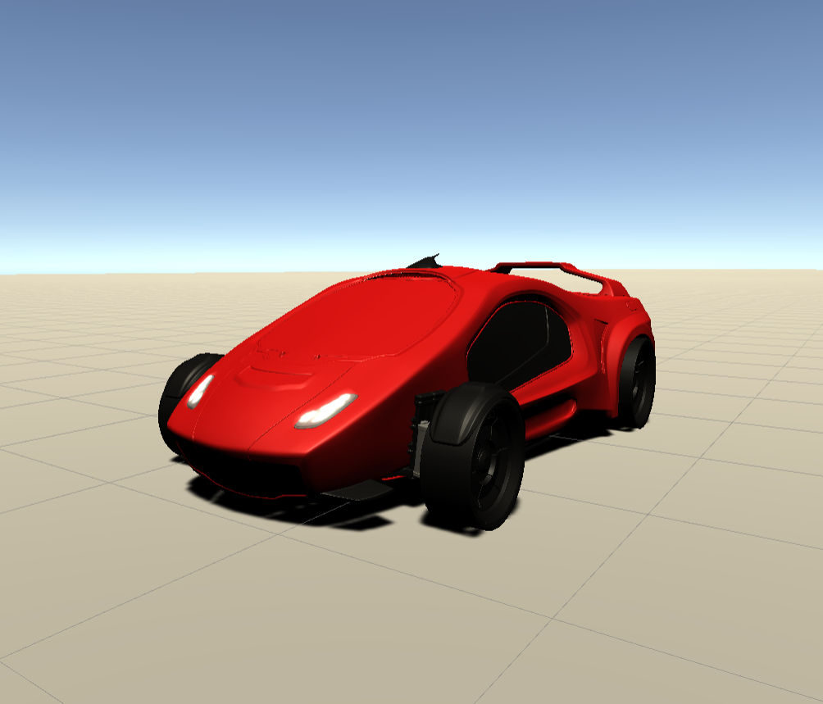
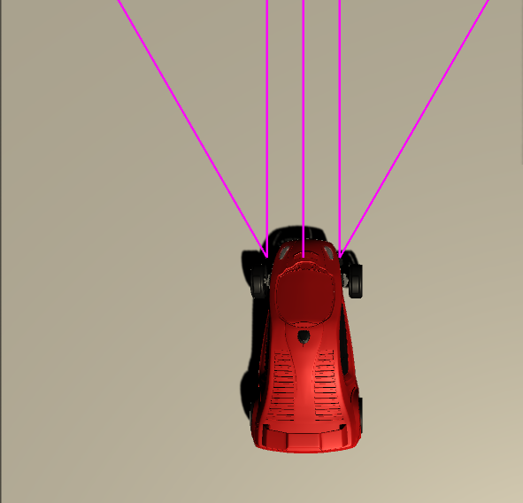
Robot Description
Robot is a car.
Fronts wheels control the turning direction.
Rear two wheel deliver power to move forward or backward.
It has 5 distance sensors, mounted in front.
Notes:
The picture in the top is the rendering of 3d model used for this project. It is a part of unity game engine’s standard assets which is open source.
Slide
3 looking forward and 2 at an angle of 30 degrees. The diagram at the bottom shows the orientation of distance sensor, each beam represents a distance sensor.

Slide 4

Assumptions
Car cannot drift.
There is no air or rolling resistance.
Sensors have enough range, noise free output.
Mapping between input value given and power delivered by robot wheels is linear.
Mapping between input value given and turning of steering wheels is linear.
Notes:
Some assumptions are made to reduce the scope of this project and keep it at a level of term project. For example perception can be implemented but it doesn’t make sense to do so in this context. The neural network trained is only responsible for decision make for the robot, to control how much power is going where.
slide

Slide 5
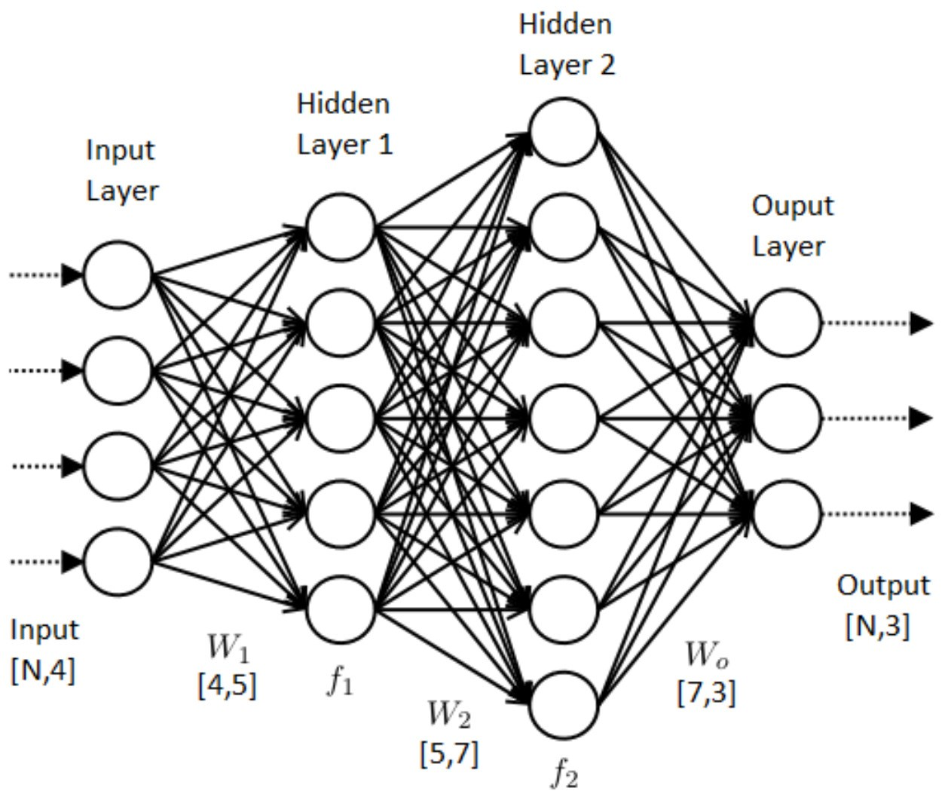
Why Artificial Neural Network?
Generalization is ability of machine learning model to fit unseen data.
Artificial Neural Networks are best option right now for it.
They can be scaled and trained and more complex dataset.
Notes:
Generalization is key ability; the model should be able to handle unseen data. Artificial neural networks are chosen for this task. They can be easily scaled and trained for a greater number of inputs and outputs. For the project, the network has 2 fully connected hidden layers, 5 neurons in input layer one for each sensor and 2 neurons in output layer one for power and one for steering. Hyperbolic tangent function is used for activation of each neuron, as other activation functions clip out the negative part of signal, in our case it is required as it represents opposite direction.

Slide 6
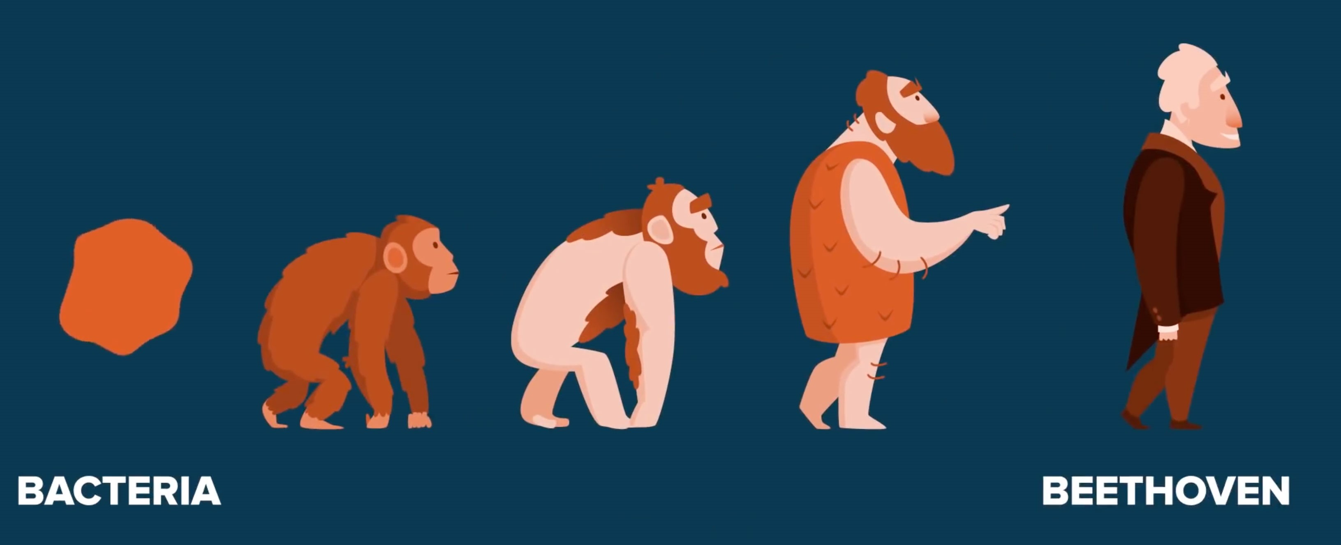
Working
Instead of using backpropagation to update weight, evolutionary approach is used.
10 individuals are generated at random and tested.
Based on the performance 5 individuals are eliminated and new are created by inducing random mutations to the weights.
There are 4 types of mutations:-
Flip the sign
Randomly select new weight.
Increase by a random factor.
Decrease by a random factor.
Notes:
Slide

Slide 7
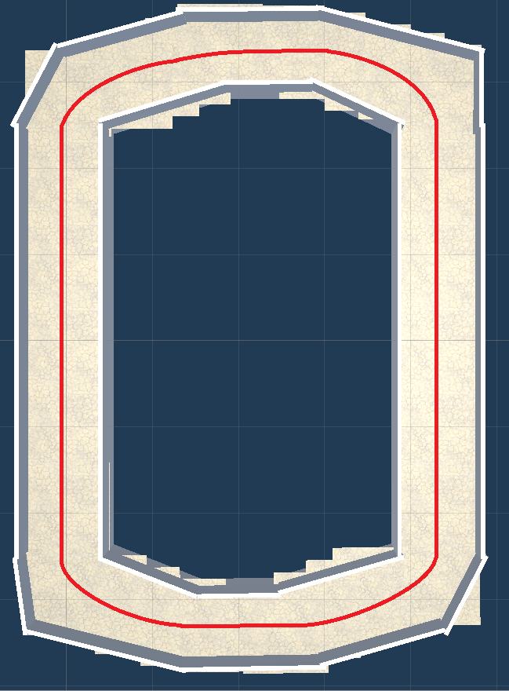
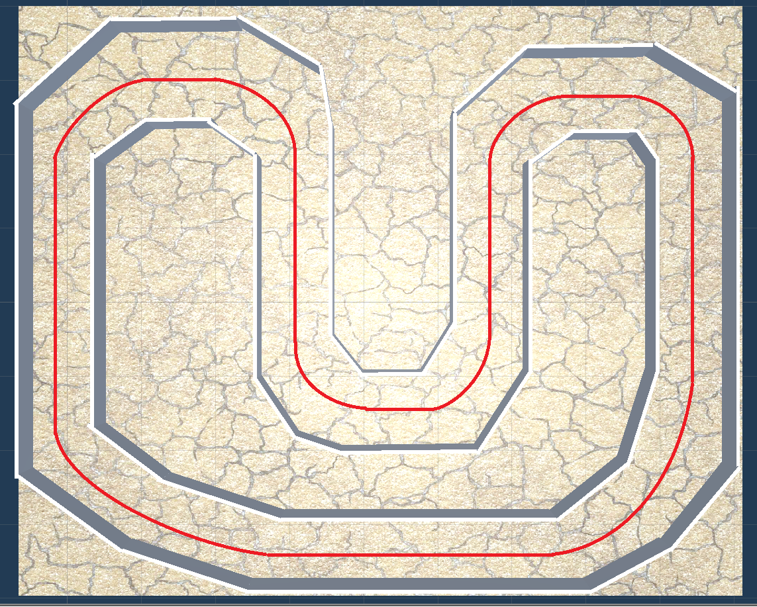
Expected Result
Notes:
These are 2 different maps used for training and testing the models. Expected path to be followed by the robot is shown in red. It goes from the exact center of the track as it is the safest route. As collision with the wall means death for an individual. But the results are much more interesting.

Slide 8
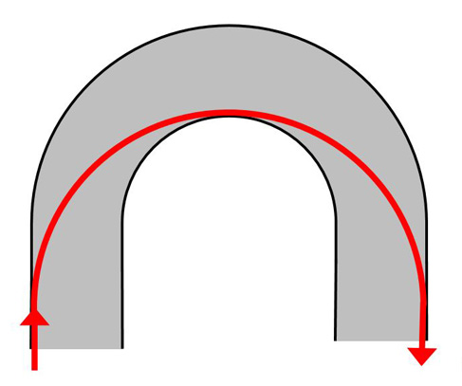
Racing line
Racing line are the most optimal path possible on a track.
Following racing line allows the racer to corner at maximum speed possible.
Notes:
Slide

Slide 9
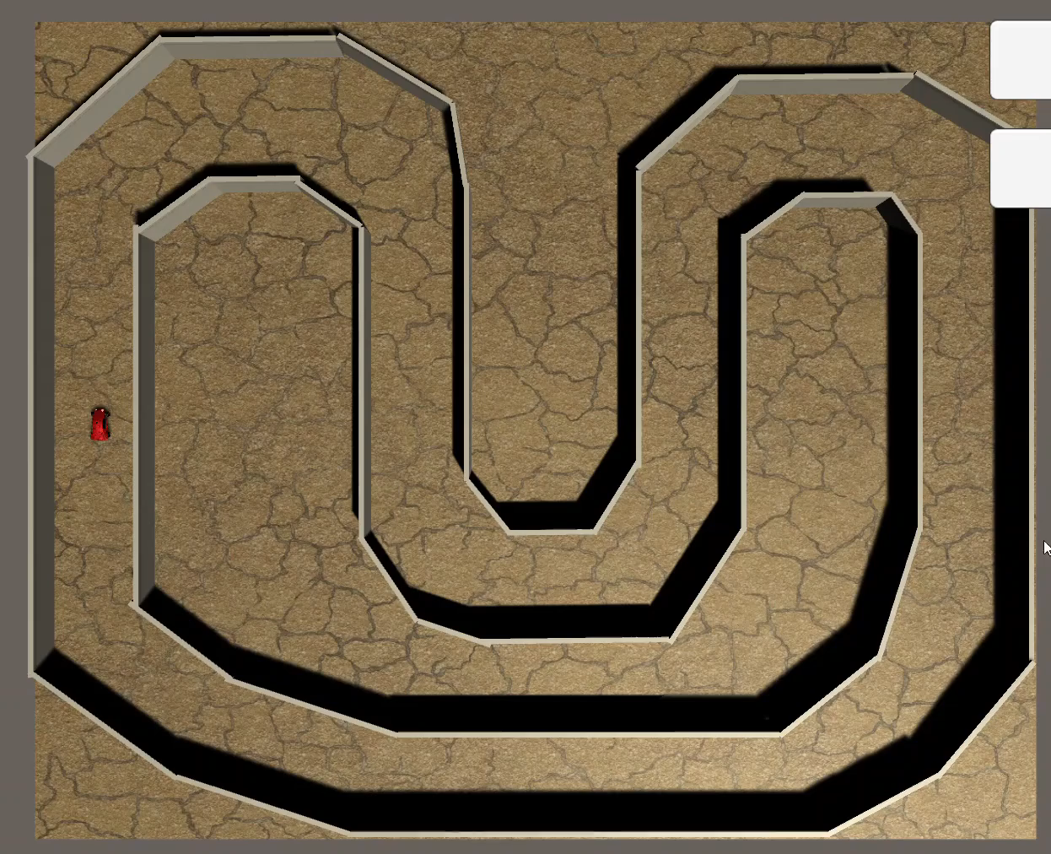
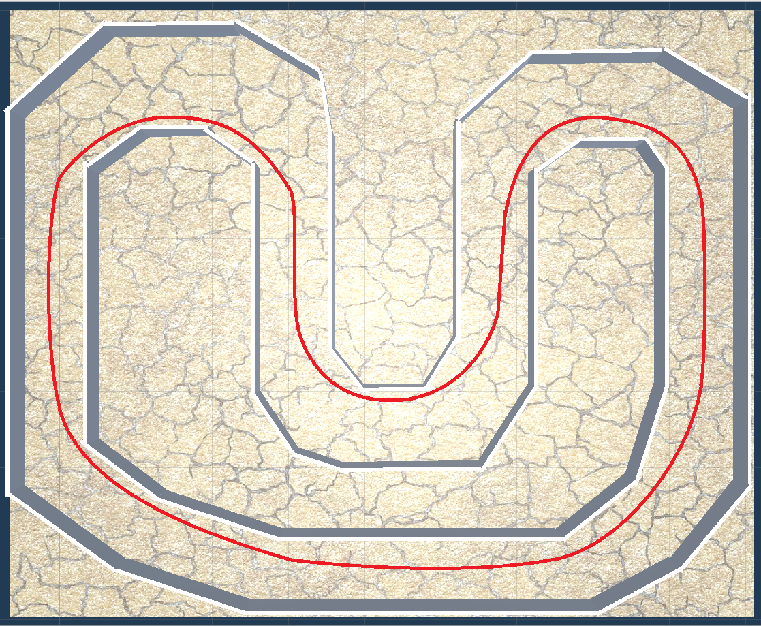
Results (Complex Track)
Notes:
As you can see the robot is following racing lines. At some position it comes dangerously close to the wall. But after about 150 generations of training, it does not crash. This the track on which the robot is trained.

Slide 10
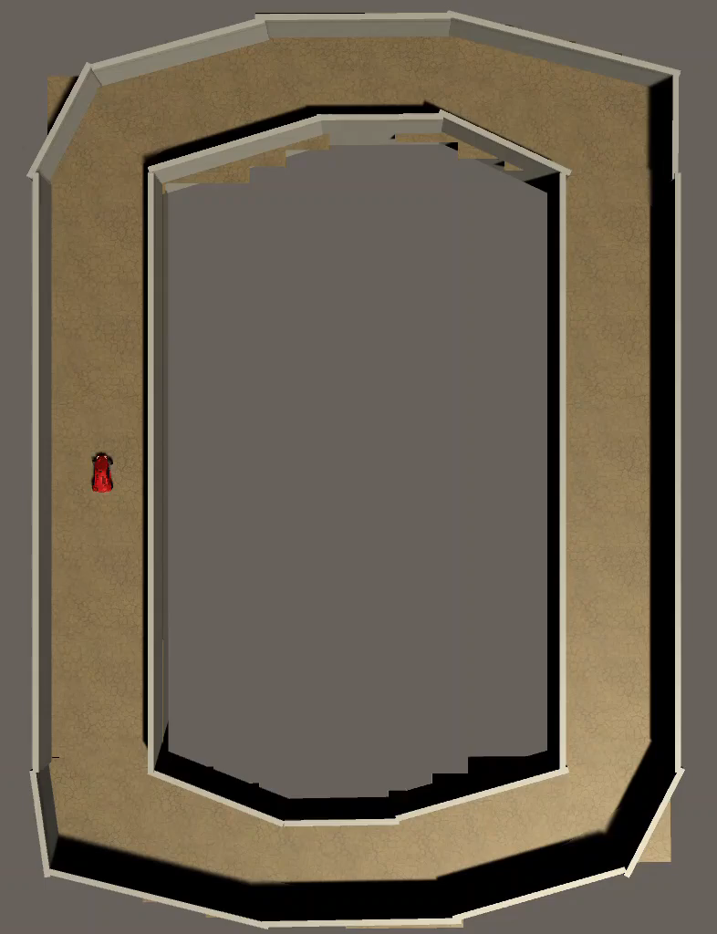
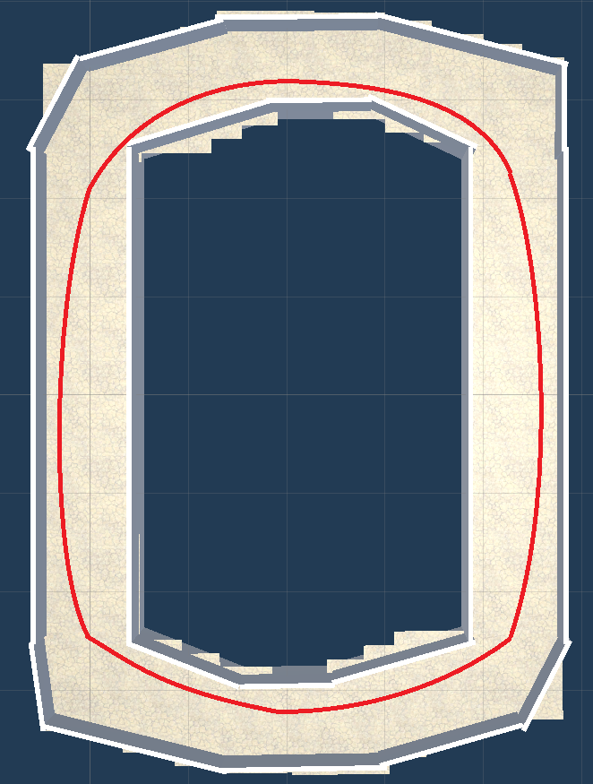
Results (Simple Track)
Notes:
This track although simple is unknown to the robot. But still as you can see it is following the racing lines.

Slide 11
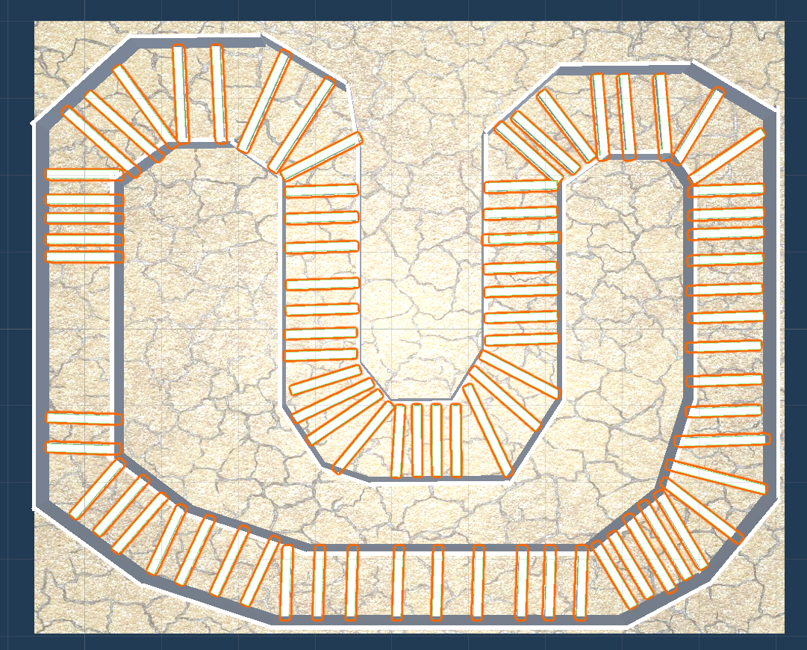
Reward function
Maximum number of checkpoints in least amount of time.
Notes:
The reason for this is the reward function. As shown in the diagram map has checkpoints, upon crossing each checkpoint positive reward is given. Robot has 60 seconds to get maximum score and the one with better score lives. These checkpoints are disabled while testing.

Slide 12

Tools Used
Unity Game Engine
Notes:
Only tool used to implement the project is unity, which is free to use, and it has collection of different open source 3d models which can be used in our project such as the 3d model for car. Everything required such as neural networks and evolution manager is implemented from scratch.

Slide 13
Thank You

Slide 14
Questions?

Slide 15
References
[1] Unity 3D: - https://docs.unity3d.com/Manual/index.html
[2] Neural networks: - https://en.wikipedia.org/wiki/Artificial_neural_network
[3] Genetic algorithm: - https://en.wikipedia.org/wiki/Genetic_algorithm
[4] Autonomous Vehicle Control System as a Mobile Robot by Artificial Neural Network; Nazmul Haque, Md Hasnat Riaz
[5] A simple algorithm for optimization and model fitting: AGA (asexual genetic algorithm); J. Canto, S. Curiel, E. Martinez-Gomez

Slide 16
Sources
Slide 1(Waymo): https://robots.ieee.org/robots/waymo/waymo-thumb@2x.jpg
Slide 2(Tesla):https://p7.hiclipart.com/preview/628/731/729/tesla-roadster-sports-car-tesla-motors-car.jpg
Silde 4(Race car icon): https://d2gg9evh47fn9z.cloudfront.net/800px_COLOURBOX23595241.jpg
Slide 5(Neural Network): https://miro.medium.com/max/2500/1*ZB6H4HuF58VcMOWbdpcRxQ.png
Slide 6(Evolution): https://www.discovery.org/m/2019/10/evolution-bacteria-beethoven-prageru.jpg
Slide 8(Racing line): http://ipacenotes.com/UserDocsImages/blog/implicitno-pravilo1.jpg
Slide 12(Unity Logo): https://www.motiva.ai/wp-content/uploads/2019/04/unity-logo.png
Project GitHub Repository: - https://github.com/ToyasDhake/Autonomous-Driving-Vehicle
Output video: - https://www.youtube.com/watch?v=dWk-vWELtQw

